Slide 1
Predicting Winner of LOL Match
Team 7
Jianchao Li 1054645
Lin zhu 1066973
Yihao Gu 1305641

Slide 2

Introduction
Two teams 5 v 5 battle
The game is often cited as the world's largest esport (https://en.wikipedia.org/wiki/League_of_Legends)
Prediction on it will be very useful

Slide 3
Data Sources
League of Legends, Competitive matches, 2015 to 2018:
https://www.kaggle.com/chuckephron/leagueoflegends
There are five different datasets:
gold.csv contains 99061 rows
kills.csv contains 191070 rows
matchinfo.csv contains 7621 rows
mosters.csv 44249 rows
structures.csv 121387 rows

Slide 4
Program In Scala - 95.6%
Data preprocessing
Spark Mllib
Play2.X Framework *Left 4.4% part of codes are written by HTML and CSS
All unit tests
Github Repository: https://github.com/ljch9725/CSYE7200_Final_Project_Team7

Slide 5
Milestones
Week 1: Self-learn related Spark, Scala and Play skills. Clean data and do data analysis. Implement data unit test
Week 2-3: Select all possible models; train models and get the best model. Implement model unit test.
Week 4: Implement UI by Play framework. Add comments and optimize codes.
Week 5: Prepare presentation

Slide 6
Preprocess Data
Select and extract useful information as features from five datasets by Spark SQL
Training : Validation : Testing ≈ 6 : 3 : 1
Standardize data by subtracting mean and over standard deviation

Slide 7
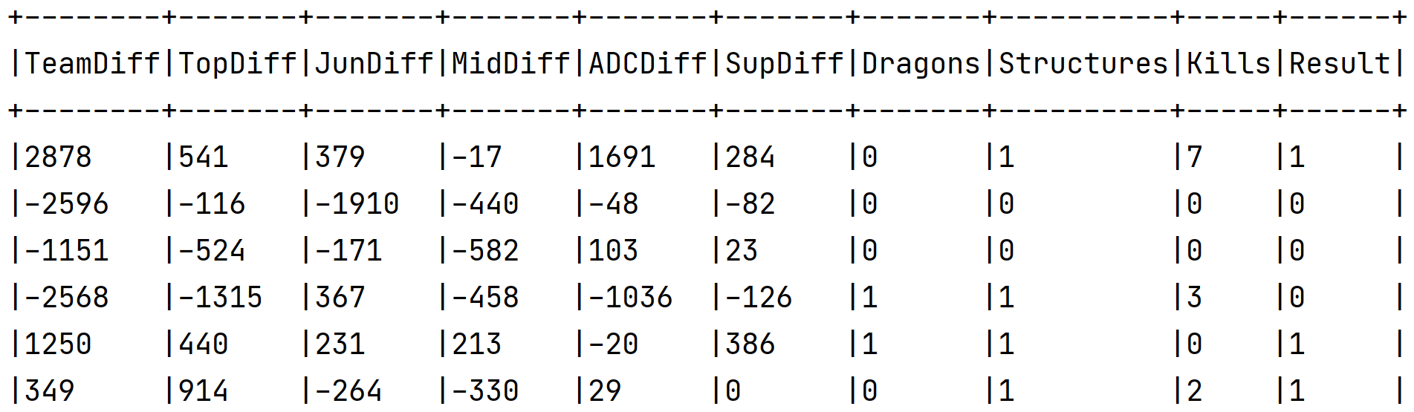
Preprocess Data
Prediction Data is shown below (first 6 columns):

Slide 8
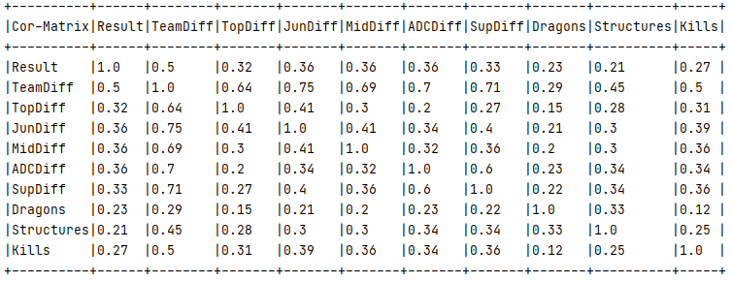
Data Analysis
Calculate the correlation of all features and label

Slide 9
Acceptance Criteria
Confusion Matrix:
 | True Class
Predicted Class | Positive | Negative
Positive | True Positive(TP) | False Positive(FP)
Negative | False Negative(FN) | True Negative(TN)
Accuracy = (TP + TN)/(P + N)
Accuracy > 70%
Response Time < 2 seconds

Slide 10
Acceptance Criteria
Model | Validation Accuracy
Decision Tree | 0.7256
Support Vector Machine(Linear) | 0.7930
Random Forest | 0.7867
Multilayer Perceptron(3 layers) | 0.7472
Logistic Regression(No Regularization) | 0.7926
Gradient-boosted Tree | 0.7832
Factorization Machines | 0.7854
Time for Training all Models:
15 - 30 minutes
Time for Loading Best model:
Approximately 1 minute
Time for predicting (Response Time):
0.05 – 0.3 seconds
Accuracy on Testing set with Best Model(SVM) = 0.7905 > 0.7

Slide 11
Methodology
Raw Data
Dataframe
MLlib
Read, Select, Extract
Train-valid, Standardize
Best Model
Prediction Results
Select, Save
Load, predict
User Inputs
Extract
Dataframe

Slide 12
Test Case
Raw dataframe should contain all rows and all columns
Raw dataframe should not contain unsuitable data
Processed dataframe should satisfy some equations
Processed dataframe should not contain NULL values
Processed dataframe should satisfy the proportion
Each model accuracy should > 70%
Each model should have 9 features
Best model accuracy should > 70%

Slide 13
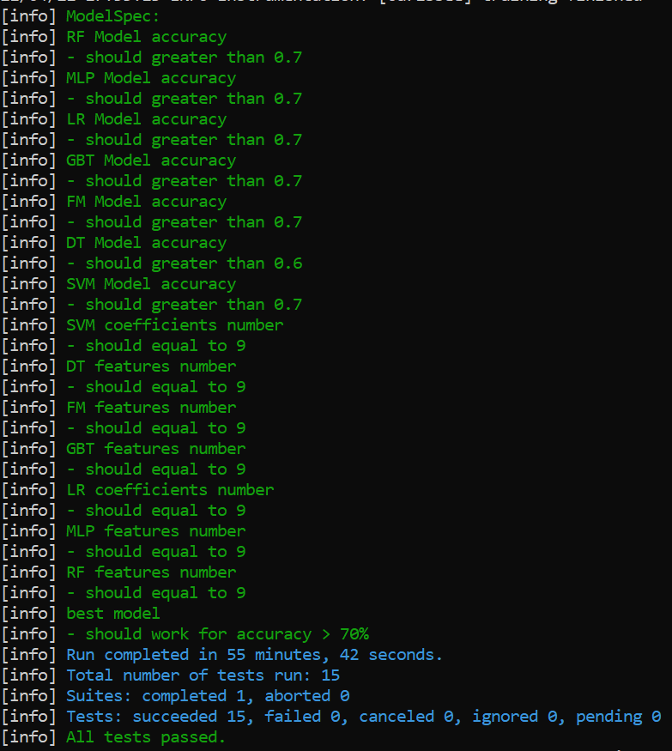
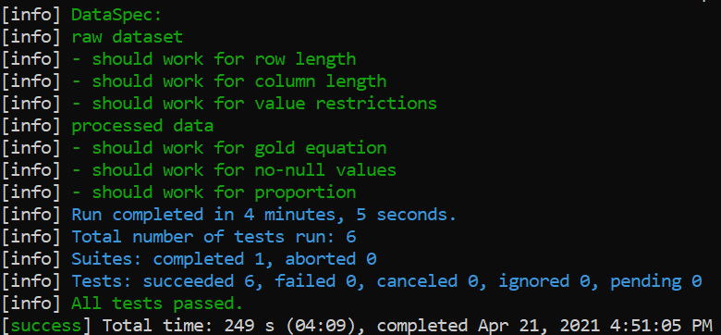
Test Case

Slide 14
Use Cases
Potential users input required information of one LOL match at first 15 minutes on website or console
System predicts which side will win based on the best model
User can see parameters of best model for further analysis

Slide 15
Goals of Project
Design a completed predicting system based on match histories.
Use information of first 15 minutes in the match to predict the final winner.
Learn related knowledge about Scala, Spark, Machine learning and Big data.

Slide 16
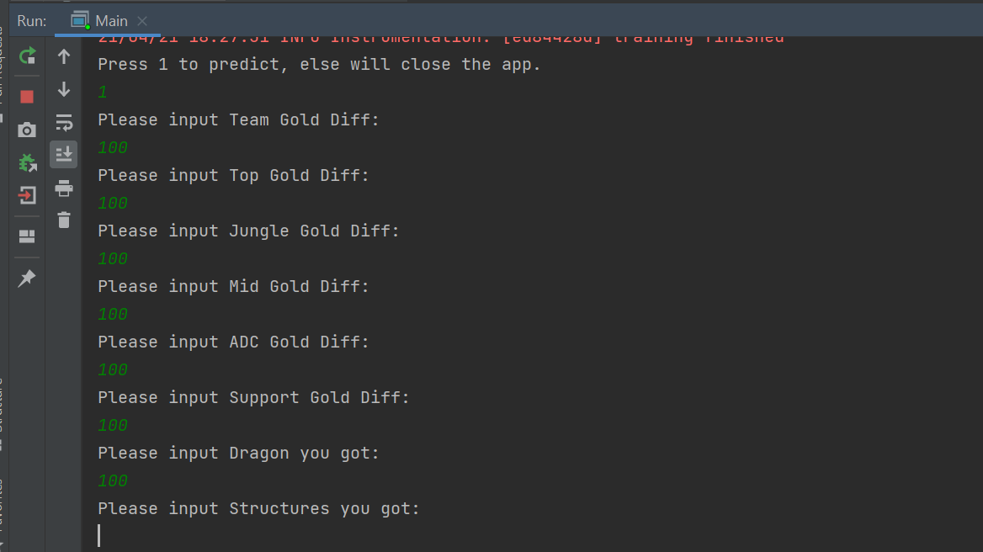
UI Demo
Console:

Slide 17
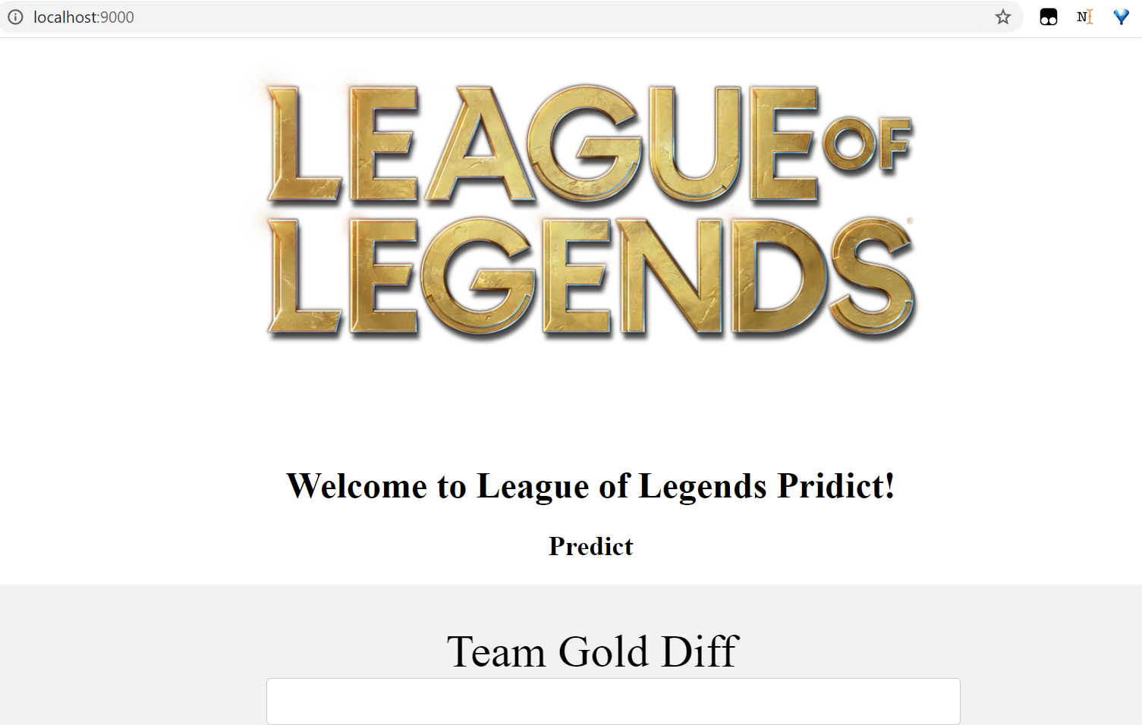
UI Demo
Website:

Slide 18
Thank You

